Slide 1
Uncovering the Online Social Structure Surrounding COVID 19
Friday, October 1, 2021

Slide 2
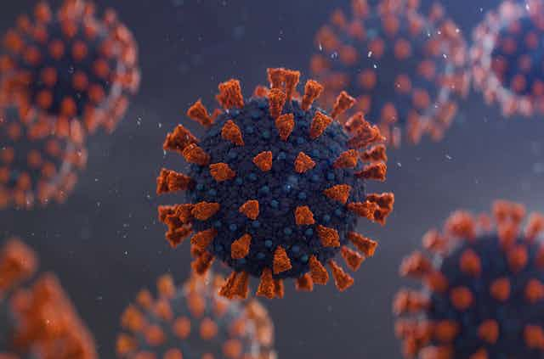

Slide 3
How Do People Discuss COVID-19 online?
Unsupervised framework was used to examine how people talk about the pandemic
A network based approach was used to identify, categorize & understand communication patterns about COVID-19 on Twitter
The findings indicated that there are distinctions between personal, global and generic threat framing of the pandemic

Slide 4
Introduction
The effects of the COVID-19 pandemic have been vast
Impacts of the pandemic on the stock market
Educational outcomes
Mental health
Effect of Effect of COVI-19

Slide 5
Introduction
Other areas of research have investigated the efficacy of governmental interventions in slowing the pandemic
Studied ethnic, racial, and income-based disparities in COVID-19 risks and severity

Slide 6
Hypothesis
To uncover how people discuss COVID-19 online
The study was to examine different cluster of similar terms used to discuss COVID-19
Three Community Detection Algorithm were developed and used to search for keywords relating to COVID-19

Slide 7
Methodology
R Tweet package
8.4 million tweets (between late March - April 2020)
4 random samples of 40,000 English tweets from initial dataset
Produced a total of 160,000 tweets for analysis
Collected tweets with #coronavirus, #coronavirusoutbreak, #coronavirusPandemic, #covid19, #covid_19, #epitwitter, #ihavecorona, #StayHomeStaySafe, and #TestTraceIsolate.
Removed Stopwords: punctuation, numbers, URLs, and also set text to lower case
Converted the text into a corpus

Slide 8
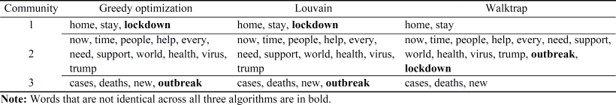
Analysis & Findings
Community 1
Community 1 focuses on the personal domain with terms
“home”, “stay”,
“lockdown” (for two of the three algorithms)
Community 2
Community focuses externally on the non-personal,
Global domain with frequent co-occurrence of terms like “support”,
“world”, “trump”, and so on
Community 3
Community focuses more generically on terms associated with the threat that comes from COVID-19 with terms like
“cases”,
“Deaths”,
“new”.
Table 1 Words by community across algorithms.

Slide 9
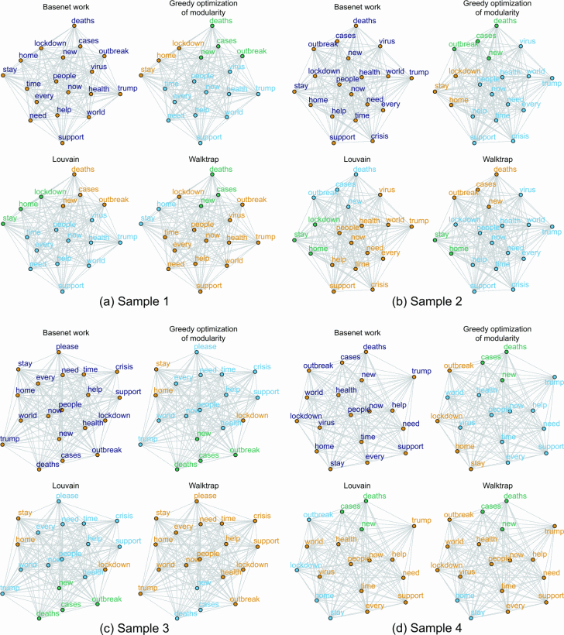
Figure 1
Community detection across three algorithms and four samples.
Notes:
Zoom Figure on Website

Slide 10
Limitation
A common problem with network studies of this sort is relying on hashtags to filter the data space
Hashtags are complex
some hashtags may be used wrongly to gain popularity rather than signalling the genuine discussion.
Future work might consider parsing and exploring Twitter and relate online discussion data in a different way, such as tweets or discussions among specific communities like academia, finance, or government.

Slide 11
Conclusion
The study is an exploratory one that allows for an unsupervised and assumption-free look at noisy Twitter data in the context of an ongoing, rapidly-developing, and complex global pandemic.

Slide 12
THANK YOU

Slide 13

ANY QUESTIONS?
Thank you

Slide 14
References
Philip D. Waggoner, Robert Y. Shapiro, Samuel Frederick, and Ming Gong
(n.d.) Uncovering the online social structure surrounding covid-19. IEEE Xplore.
Retrieved September 19, 2021, from https://ieeexplore.ieee.org/document/9520811.

